Slide 1
Tutorial Create your CV using HTML

Slide 2
HTML – Hypertext Markup Language
HTML is the language of the web, allows us to build websites
Hypertext - allows us to click on links
Markup - the language elements in HTML that make content appear as it does
Headings
Navigation
Images
Lists
Video
All markup (or tags) appear between < >

Slide 3
HTML markup/tags we will use today
h1, h2 – header
p – paragraph of text
strong – makes text bold
ul – unordered list (bullets)
ol – numbered list (1,2, 3 etc)
li – list item inside ul or ol
a – link to another page or website

Slide 4
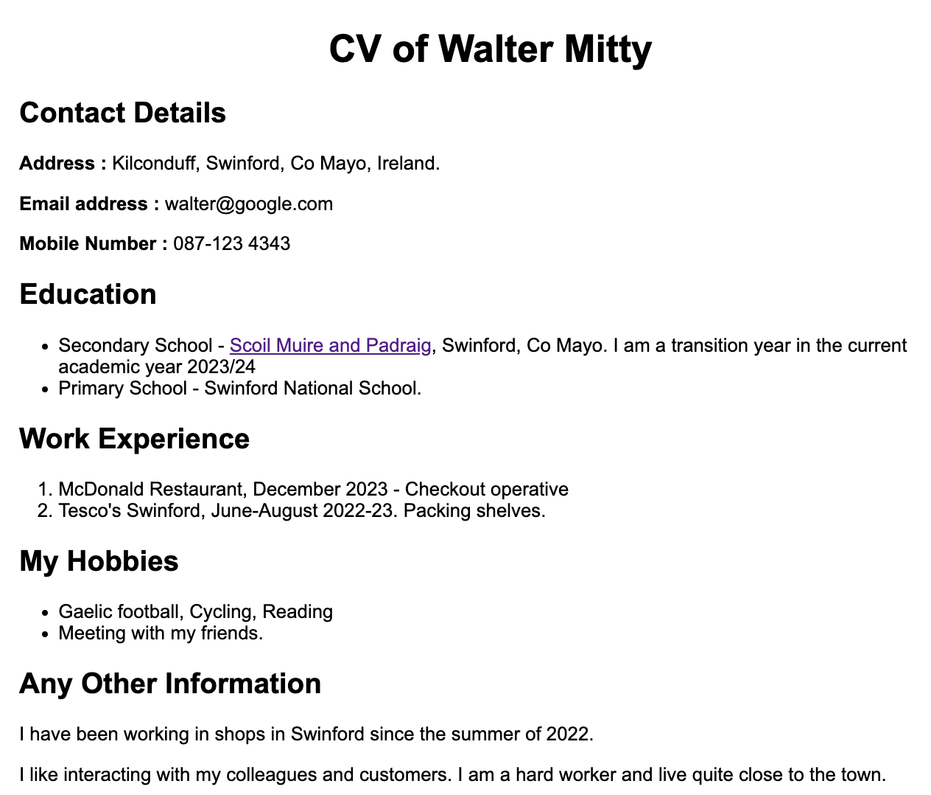
<h1>
<h2>
<p> <strong>
<h2>
<ul><li><p><a>
<h2>
<ol><li><p>
<h2>
<ul><li><p>
<h2>
<p>

Slide 5
What is development process?
Login to Lab PC
Open Visual Code or Notepad
Save a file called index.html
Start to write some basic CV details
You should just use fictional details please!
Apply some of basic HTML markup/tags
Refer to the printed materials you received – cheat sheets and Walter’s CV
Test in the browser
What does it look like? If it does not lot right, maybe you have a bug? How do we fix a bug?

Slide 6
Materials used in this Tutorial
HTML Cheatsheet
https://web.stanford.edu/group/csp/cs21/htmlcheatsheet.pdf
CSS Cheatsheet https://web.stanford.edu/group/csp/cs21/csscheatsheet.pdf
Visual Code
https://code.visualstudio.com/
Extension : Live server (Five Server) - for testing in browser
Extension – HTML CSS Support – intellisense easier coding

